Slide 1
Introduction
to
Microsoft Excel

Slide 2
MS Excel Basics

Slide 3
Objectives Overview
How to explore Excel window
How to explore the backstage view
How to enter values in excel
How to move around
How to save workbook
How to create Worksheet
How to copy worksheet
How to hide worksheet

Slide 4
Objectives Overview
How to delete worksheet
How to close workbook
How to open workbook
How to use context help in excel

Slide 5
MS Excel Basics
Microsoft Excel is a spread sheet tool capable of performing calculations, analysing data and integrating information from different programs.
Microsoft Excel is a commercial spread sheet application, written and distributed by Microsoft for Microsoft Windows and Mac OS X.
By default, documents saved in Excel 2010 upwards are saved with the .xlsx extension whereas the file extension of the prior Excel versions are .xls.

Slide 6
Getting Started Excel 2019
Office 2019 is engineered for Windows 10.
You can start Excel 2019 from the Start menu app list or tile area, the Start screen, or the taskbar search box.
You might also have a shortcut to Excel on your desktop or on the Windows taskbar.

Slide 7
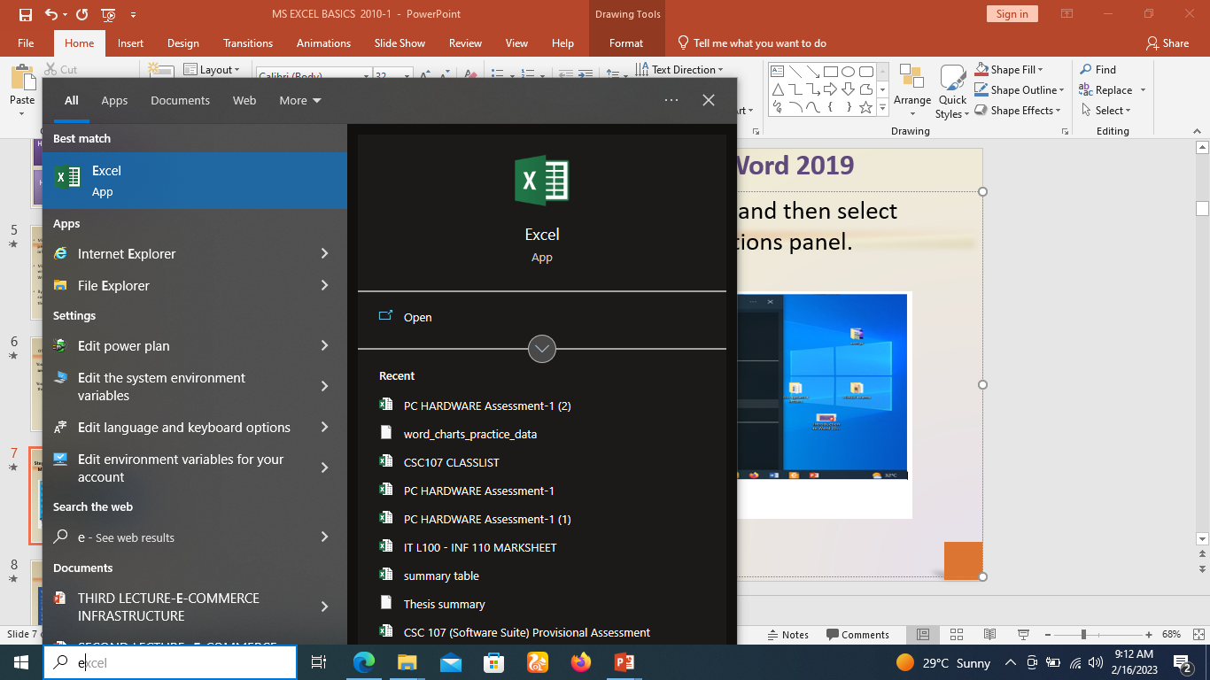
Getting Started Excel 2019
Step 1 − Click the Start button and then select Microsoft excel from the options panel.

Slide 8
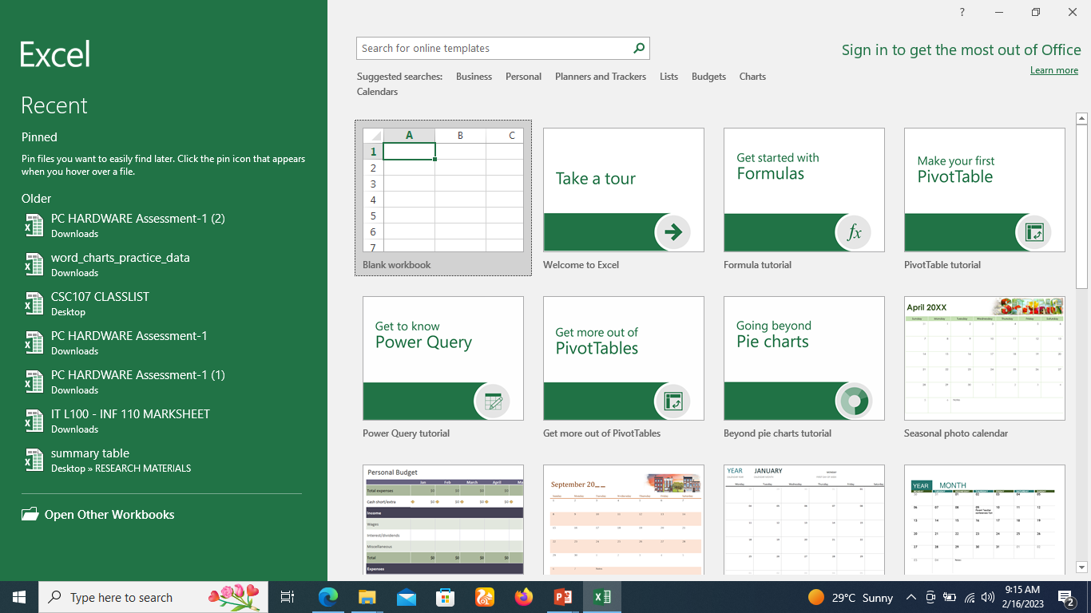
Getting Started Excel 2019
Step 2 − Click on Blank document option from the menu.

Slide 9
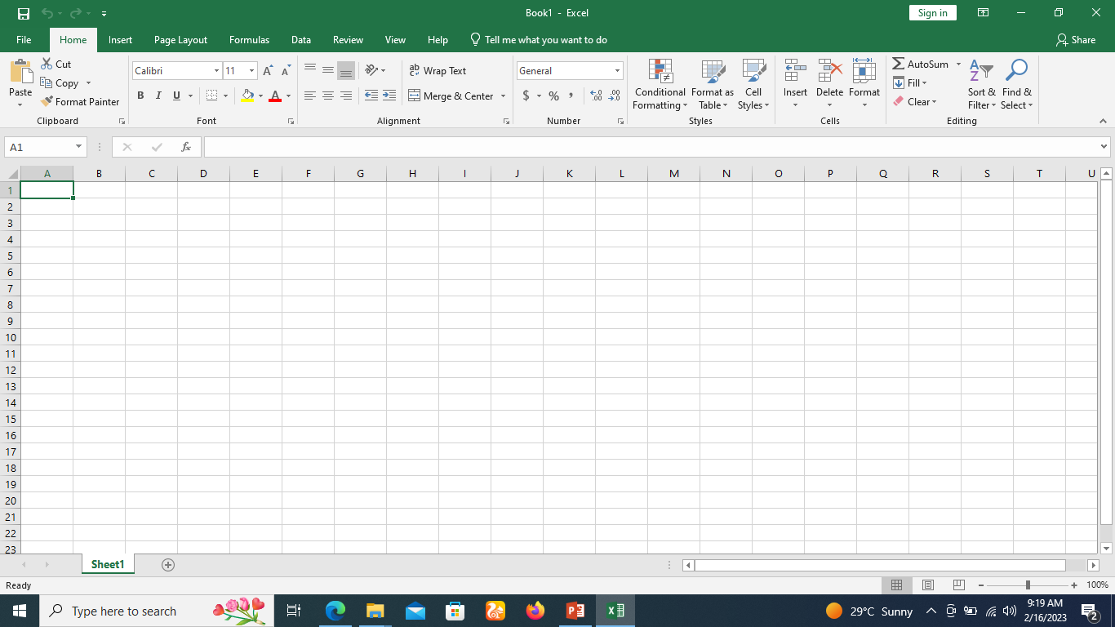
Getting Started with Excel 2019
Step 4
This will launch the Microsoft Excel 2019 application and you will see the following excel window.

Slide 10
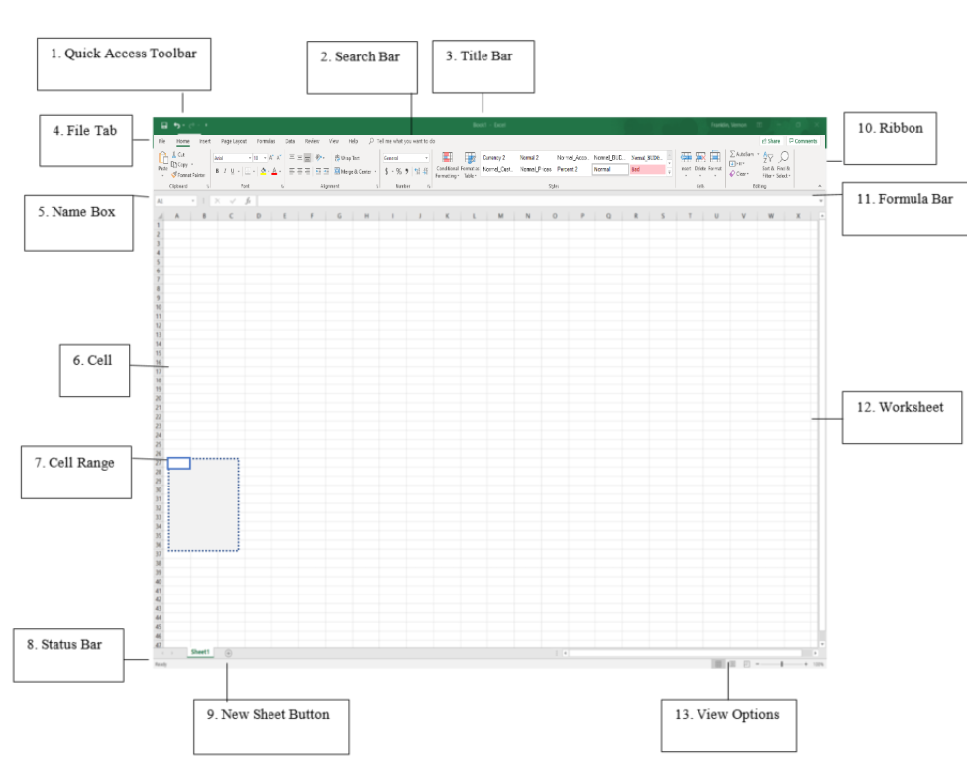
Explore Window in Excel 2019
Column

Slide 11
Explore Window in Excel 2019
File Tab
The File tab replaces the Office button from Excel 2007.
You can click it to check the Backstage view.
The backstage view enables you to open or save files, create new sheets, print a sheet, and do other file-related operations.

Slide 12
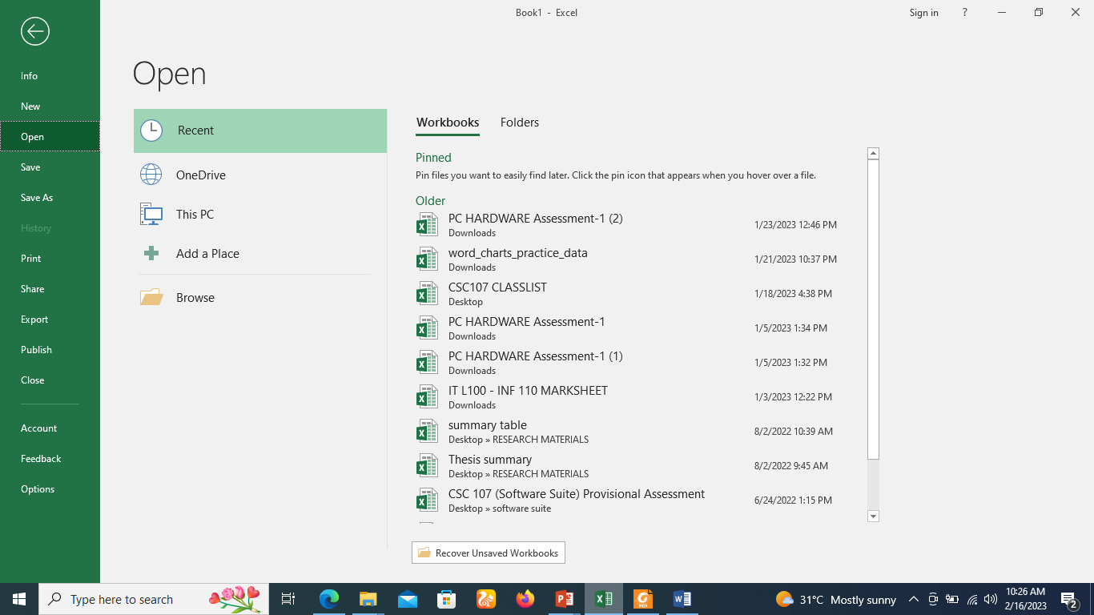
Backstage view

Slide 13
Explore Window in Excel 2019
Quick Access Toolbar
The Quick Access Toolbar can be located in one of two places: Upper-left corner, on the title bar. (default location)
The Quick Access Toolbar can also be relocated below the ribbon.
Its purpose is to provide a convenient resting place for the Excel's most frequently used commands.

Slide 14
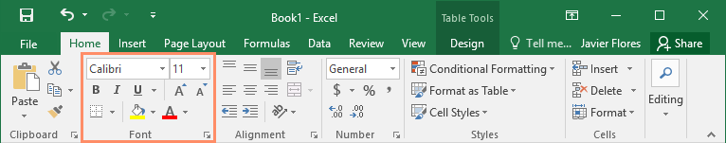
Explore Window in Excel 2019
Ribbon
Ribbon contains commands organized in three components −
Tabs − They appear across the top of the Ribbon and contain groups of related commands. Home, Insert, Page Layout are the examples of ribbon tabs.
Groups − They organize related commands; each group name appears below the group on the Ribbon. For example, group of commands related to fonts or group of commands related to alignment etc.
Commands − Commands appear within each group as mentioned above.

Slide 15
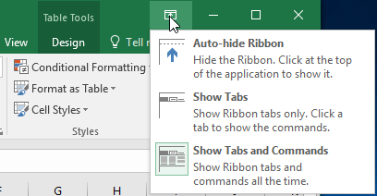
Showing and hiding the Ribbon
If you find that the Ribbon takes up too much screen space, you can hide it.
To do this, click the Ribbon Display Options arrow in the upper-right corner of the Ribbon, then select the desired option from the drop-down menu:

Slide 16
Explore Window in Excel 2019
Title Bar
This lies in the middle and at the top of the window.
Title bar shows the program and the sheet titles.
Using the Tell me feature
The tell me feature can be used to get excel related help anytime you like.
This provides nice tutorial on various subjects related to excel.

Slide 17
Explore Window in Excel
Zoom Control
Zoom control lets you zoom in for a closer look at your text.
The zoom control consists of a slider that you can slide left or right to zoom in or out.
The + and - buttons can be clicked to increase or decrease the zoom factor

Slide 18

Explore Window in Excel
Worksheet views.
The group of three buttons located to the left of the Zoom control, near the bottom of the screen, lets you switch among Excel's various sheet views.
Normal Layout view − This displays the page in normal view.
Page Layout view − This displays pages exactly as they will appear when printed. This gives a full screen look of the document.
Page Break view − This shows a preview of where pages will break when printed.

Slide 19
Explore Window in Excel
Sheet Area
The area where you enter data.
The flashing vertical bar is called the insertion point.
It represents the location where text will appear when you type.

Slide 20
Explore Window in Excel
Row Bar
Rows are numbered from 1 onwards and keeps on increasing as you keep entering data.
Maximum limit is 1,048,576 rows.
Column Bar
Columns are numbered from A onwards and keeps on increasing as you keep entering data.
After Z, it will start the series of AA, AB and so on. Maximum limit is 16,384 columns.

Slide 21
Explore Window in Excel
Status Bar.
This displays the current status of the active cell in the worksheet.
A cell can be in either of these fours states:
Ready mode which indicates that the worksheet is ready to accept user input.
Edit mode indicates that cell is in editing mode, if it is not activated then you can activate editing mode by double-clicking on a cell.
A cell enters into Enter mode when a user types data into a cell.
Point mode triggers when a formula is being entered using a cell reference by mouse pointing or the arrow keys on the keyboard.

Slide 22
Entering Values in Excel
Sheet area is the place where you type your text.
The flashing vertical bar is called the insertion point and it represents the location where text will appear when you type.
When you click on a box then the box is highlighted.
When you double click the box, the flashing vertical bar appears and you can start entering your data.

Slide 23
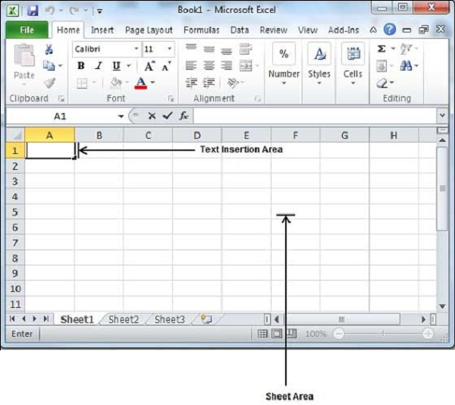
Entering Values in Excel

Slide 24
Entering Values in Excel
keep your mouse cursor at the text insertion point and start typing whatever text you would like to type.
We have typed only two words "Hello Excel" as shown below.
The text appears to the left of the insertion point as you type.

Slide 25
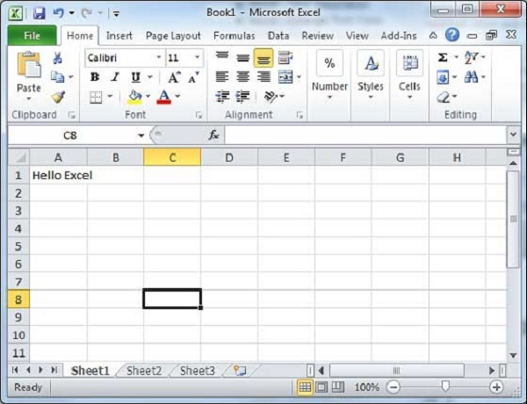
Entering Values in Excel
There are following three important points, which would help you while typing −
Press Tab to go to next column.
Press Enter to go to next row.
Press Alt + Enter to enter a new line in the same column.

Slide 26
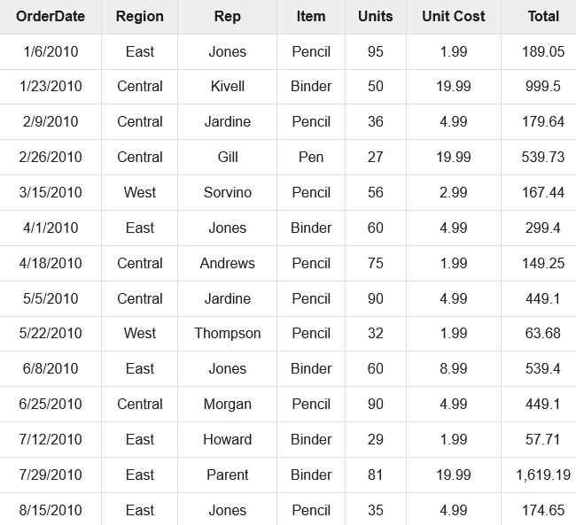
Entering Values in Excel

Slide 27
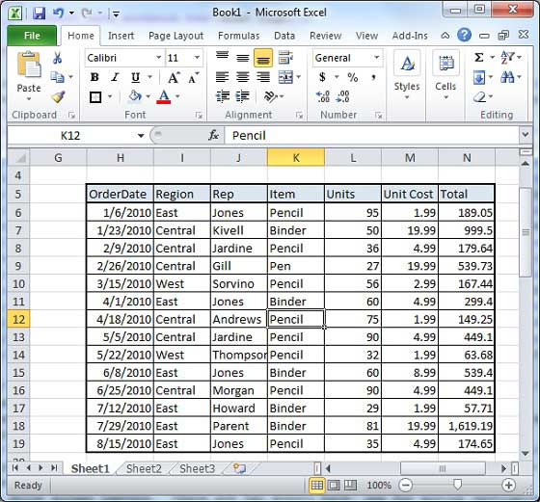
Entering Values in Excel

Slide 28
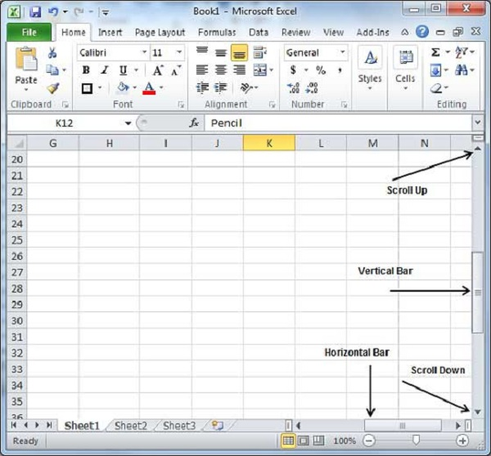
Entering Values in Excel
Moving with Mouse

Slide 29
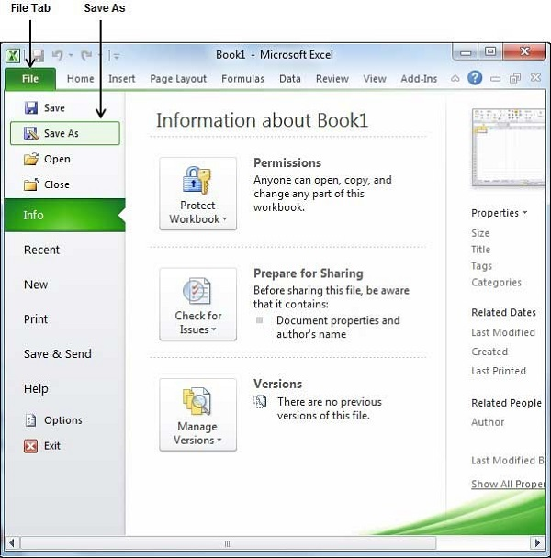
Save Workbook in Excel
Step 1
Click the File tab and select Save As option.

Slide 30
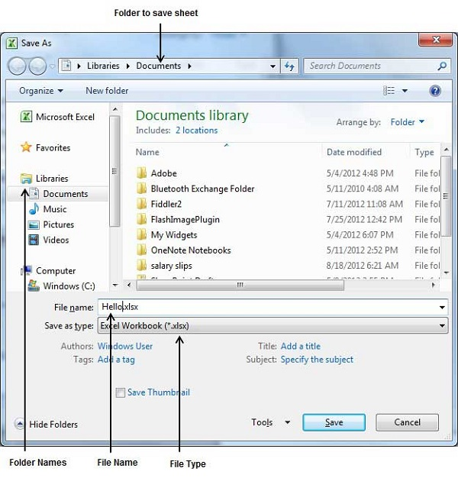
Save Workbook in Excel
Step 2
Select a folder where you would like to save the sheet, Enter file name, which you want to give to your sheet and Select a Save as type, by default it is .xlsx format.

Slide 31
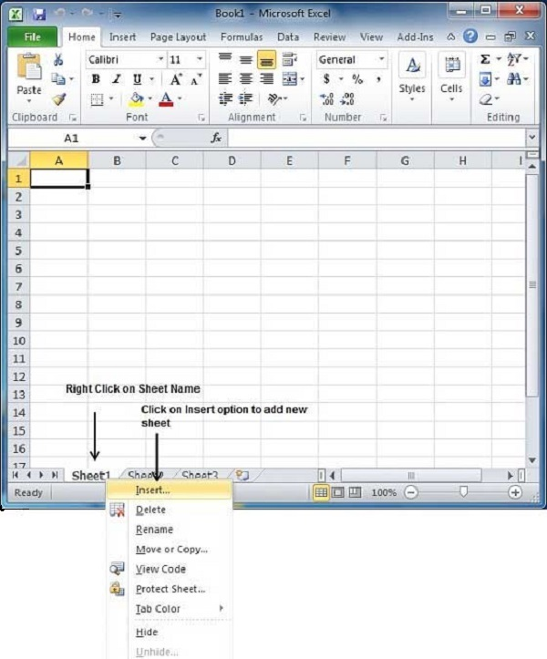
Creating New Worksheet
Step 1
Right Click the Sheet Name and select Insert option.

Slide 32
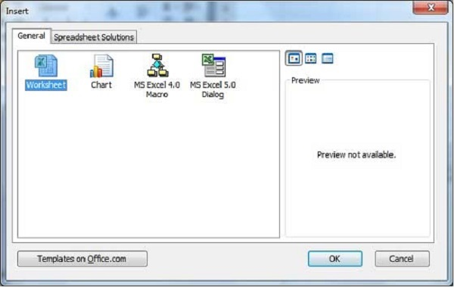
Creating New Worksheet
Step 2
Now you'll see the Insert dialog with select Worksheet option as selected from the general tab. Click the Ok button.

Slide 33
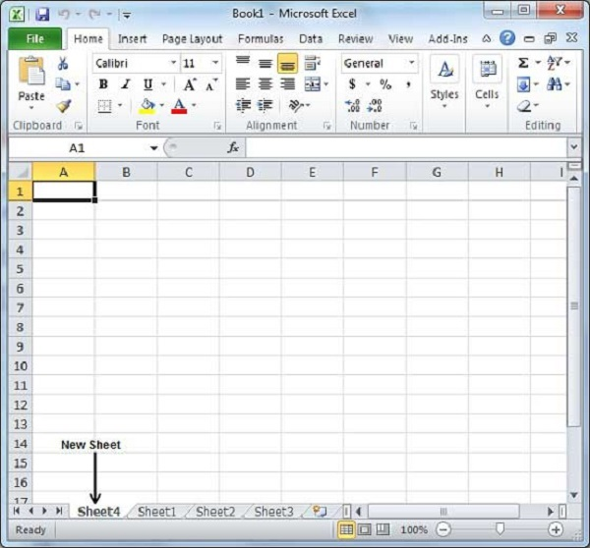
Creating New Worksheet
Step 2
Now you should have your blank sheet as shown below ready to start typing your text.
You can use a short cut Shift+F11 to create a blank sheet anytime.

Slide 34
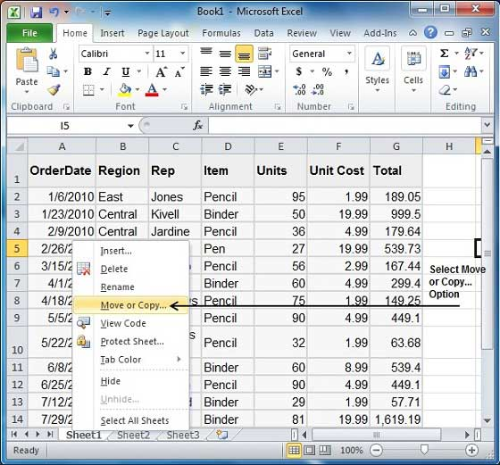
Copy Worksheet in Excel
Step 1
Right Click the Sheet Name and select the Move or Copy option.

Slide 35
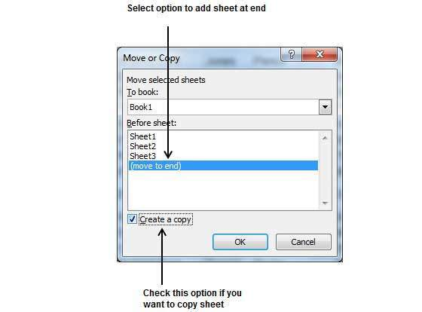
Copy Worksheet in Excel
Step 2
Now you'll see the Move or Copy dialog with select Worksheet option as selected from the general tab. Click the Ok button.

Slide 36
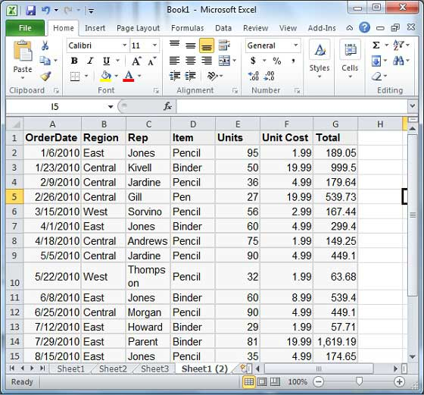
Copy Worksheet in Excel
You can rename the sheet by double clicking on it. On double click, the sheet name becomes editable. Enter any name say Sheet5 and press Tab or Enter Key.

Slide 37
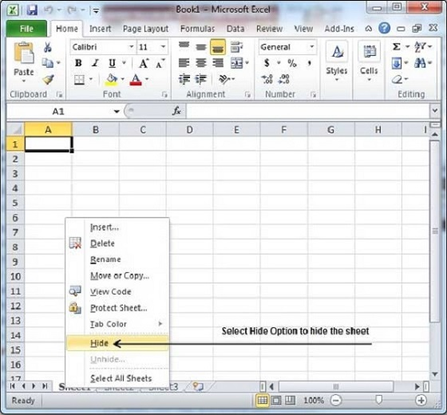
Hiding Worksheet
Step 1
Right Click the Sheet Name and select the Hide option. Sheet will get hidden.

Slide 38
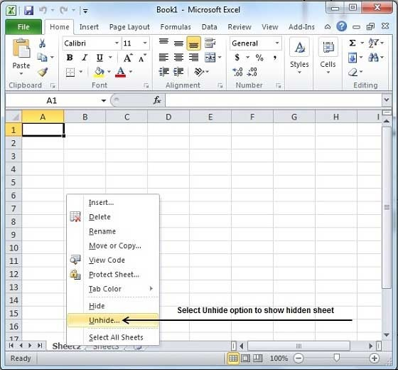
Unhiding Worksheet
Step 1
Right Click on any Sheet Name and select the Unhide... option.

Slide 39
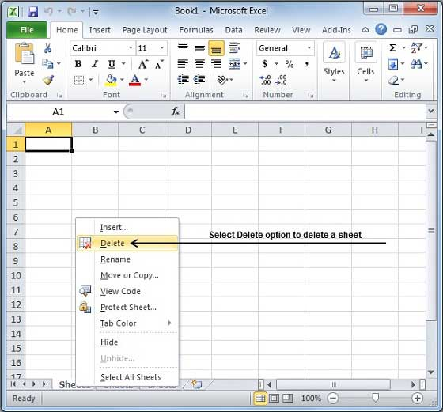
Delete Worksheet in Excel
Step 1
Right Click the Sheet Name and select the Delete option.

Slide 40
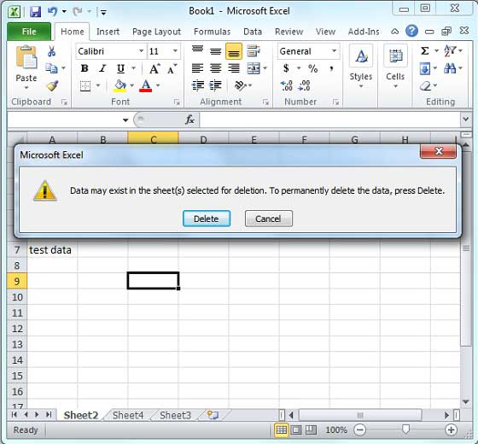
Delete Worksheet in Excel
Step 2
Sheet will get deleted if it is empty, otherwise you'll see a confirmation message.
Press the Delete Button.

Slide 41
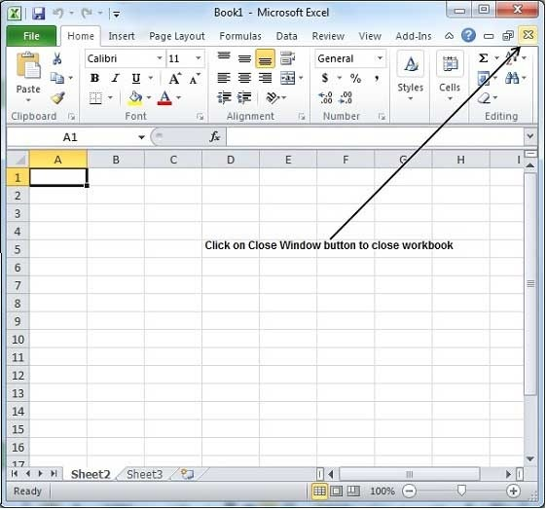
Close Workbook in Excel
Step 1
Click the Close Button as shown below.

Slide 42
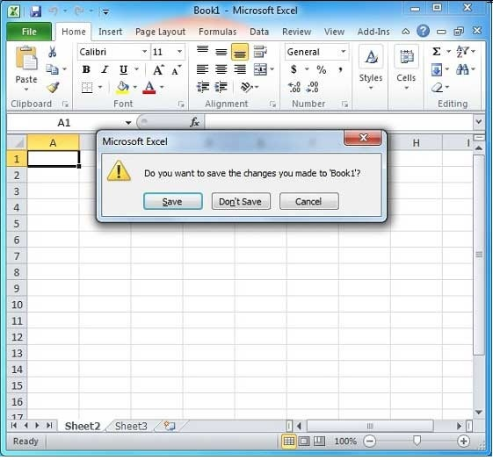
Close Workbook in Excel 2010
Step 2
You'll see a confirmation message to save the workbook.
Press the Save Button to save the workbook as we did in MS Excel - Save Workbook

Slide 43
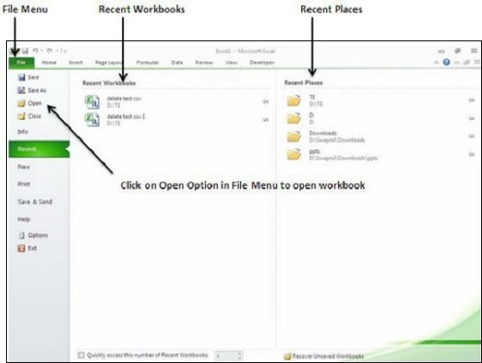
Open Workbook in Excel
Step 1
Click the File Menu as shown below. You can see the Open option in File Menu.

Slide 44
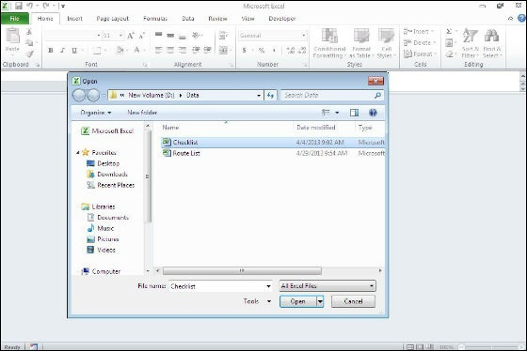
Open Workbook in Excel
Step 2
Clicking the Open Option will open the browse dialog as shown below. Browse the directory and find the file you need to open.

Slide 45
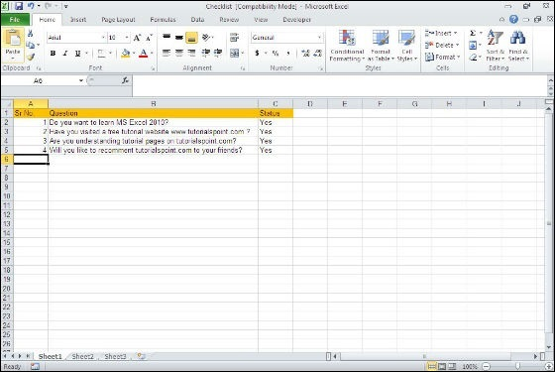
Open Workbook in Excel
Step 3
Once you select the workbook your workbook will be opened as below.

Slide 46
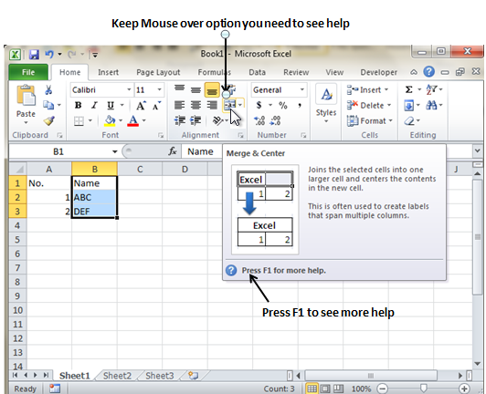
Context Help in Excel
Step 1
MS Excel provides context sensitive help on mouse over.
To see context sensitive help for a particular Menu option, hover the mouse over the option for some time.
Then you can see the context sensitive Help as shown below.

Slide 47


Slide 48
THANK YOU

